Slide 1
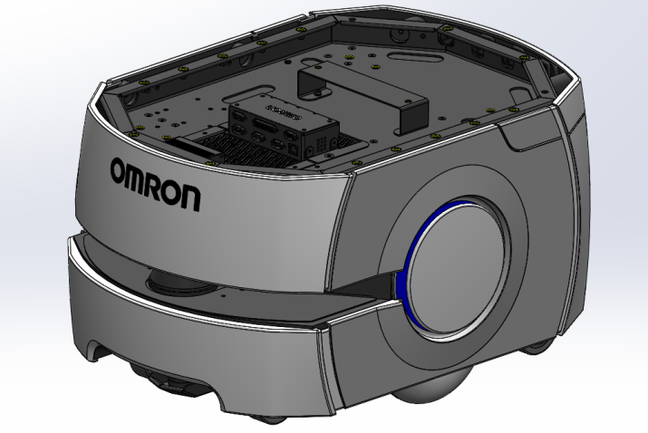
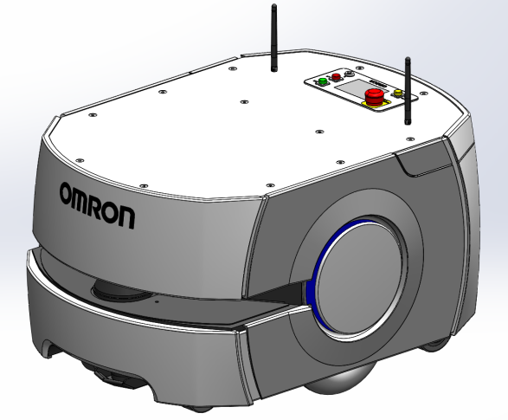
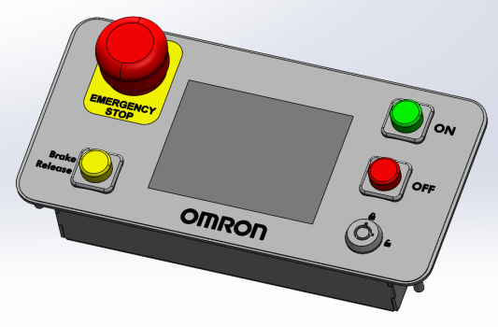
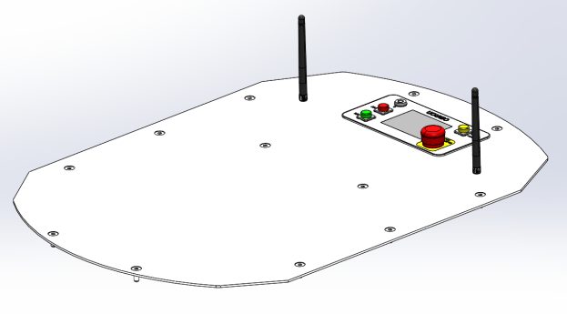
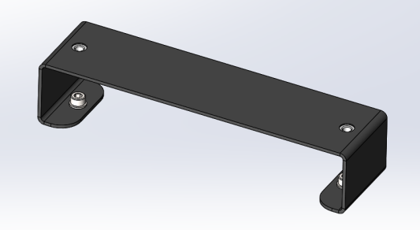
LD Platform and Cart CAD files
LD Platform CAD Files
Operator Panel
LD Platform
LD Platform With Top Plate
LD Platform Deck Brace
LD Platform Top Plate

Slide 2
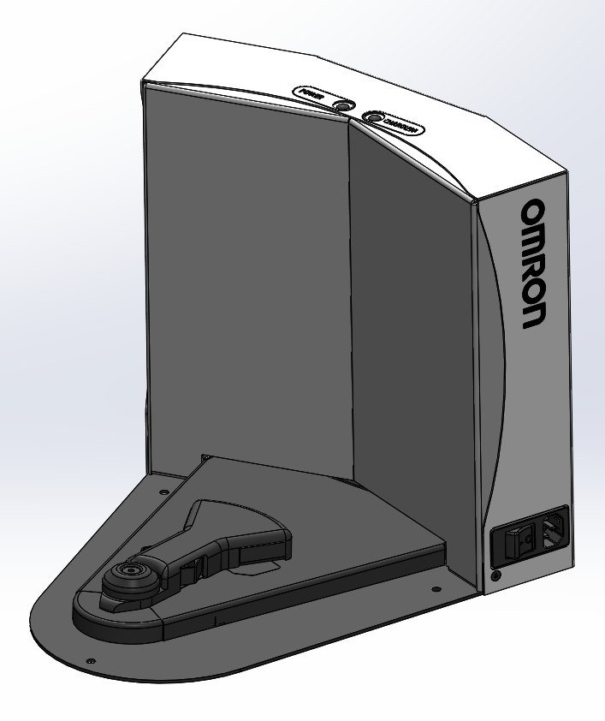
LD Platform and Cart CAD files
LD Docking Station CAD Files
LD Docking Station

Slide 3
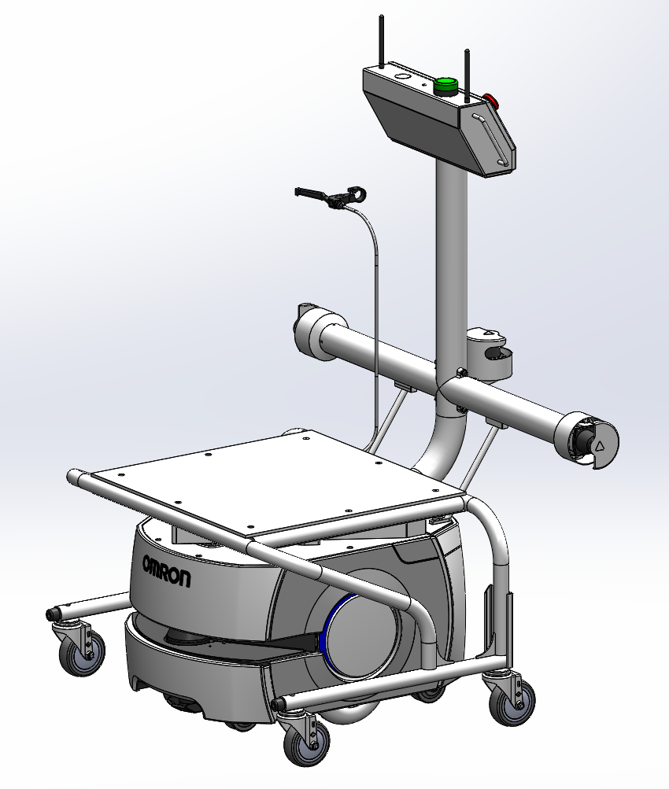
LD Platform and Cart CAD files
LD Cart Transporter CAD Files
LD Cart Transporter

Slide 4
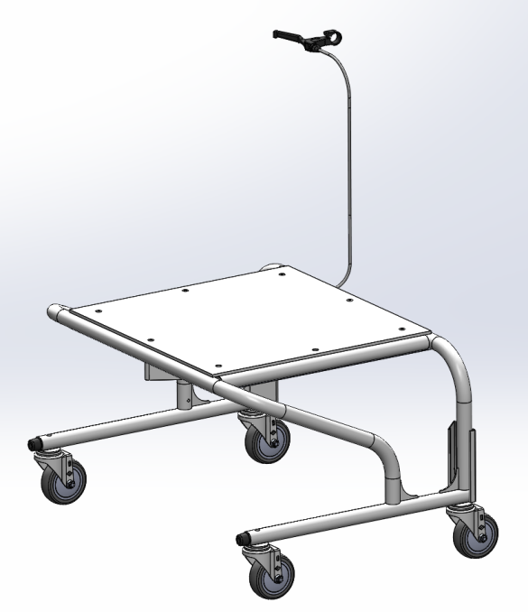
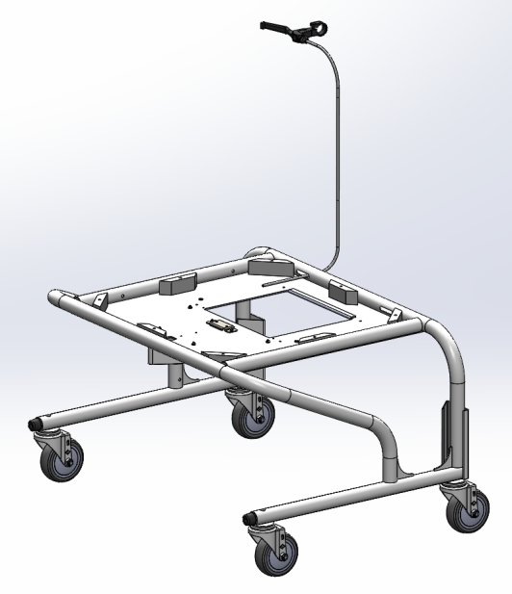
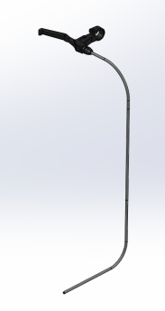
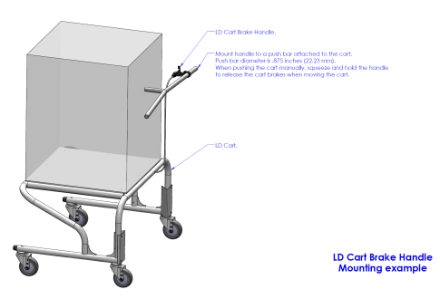
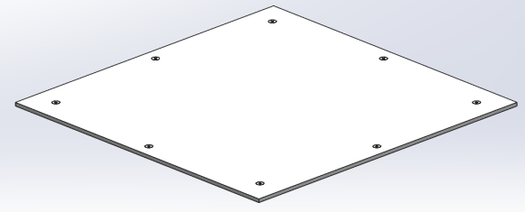
LD Platform and Cart CAD files
LD Cart CAD Files
LD Cart Without Top Plate
LD Cart
LD Cart Brake Handle
LD Cart Brake Handle Mounting
LD Cart Top Plate

